Slide 1

Project Report Blue Hills App Development Project By Smit Shah

Slide 2
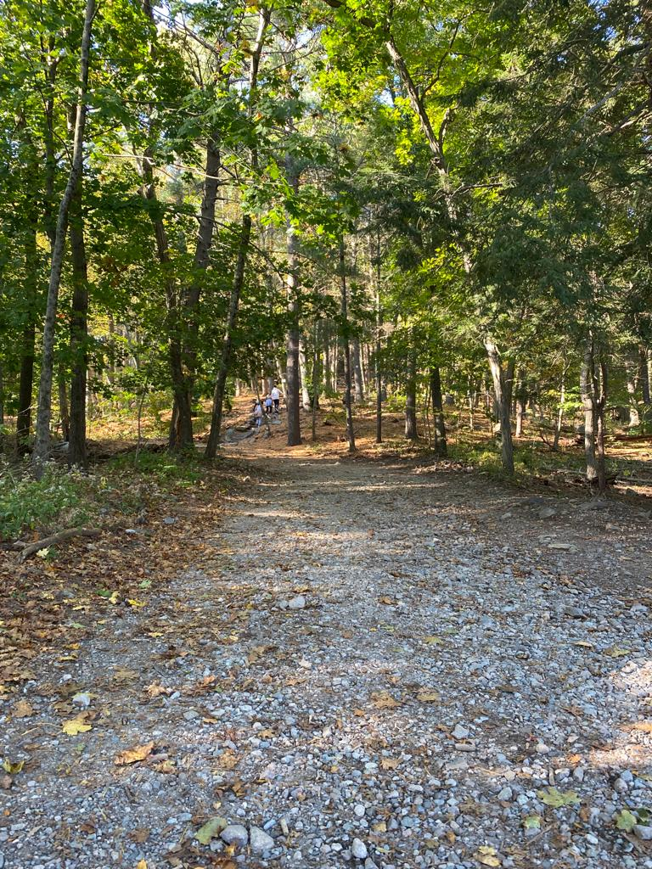
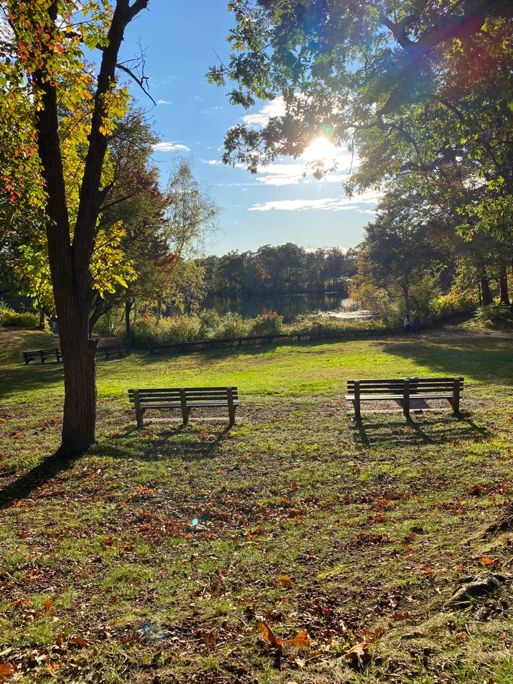
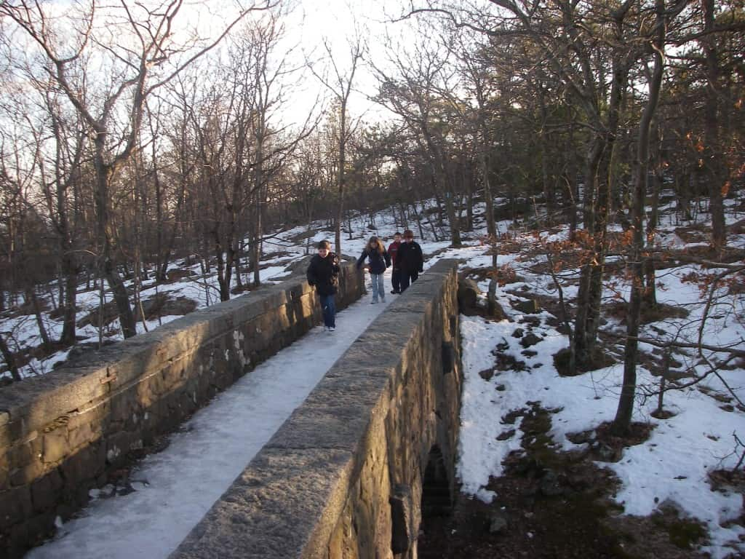
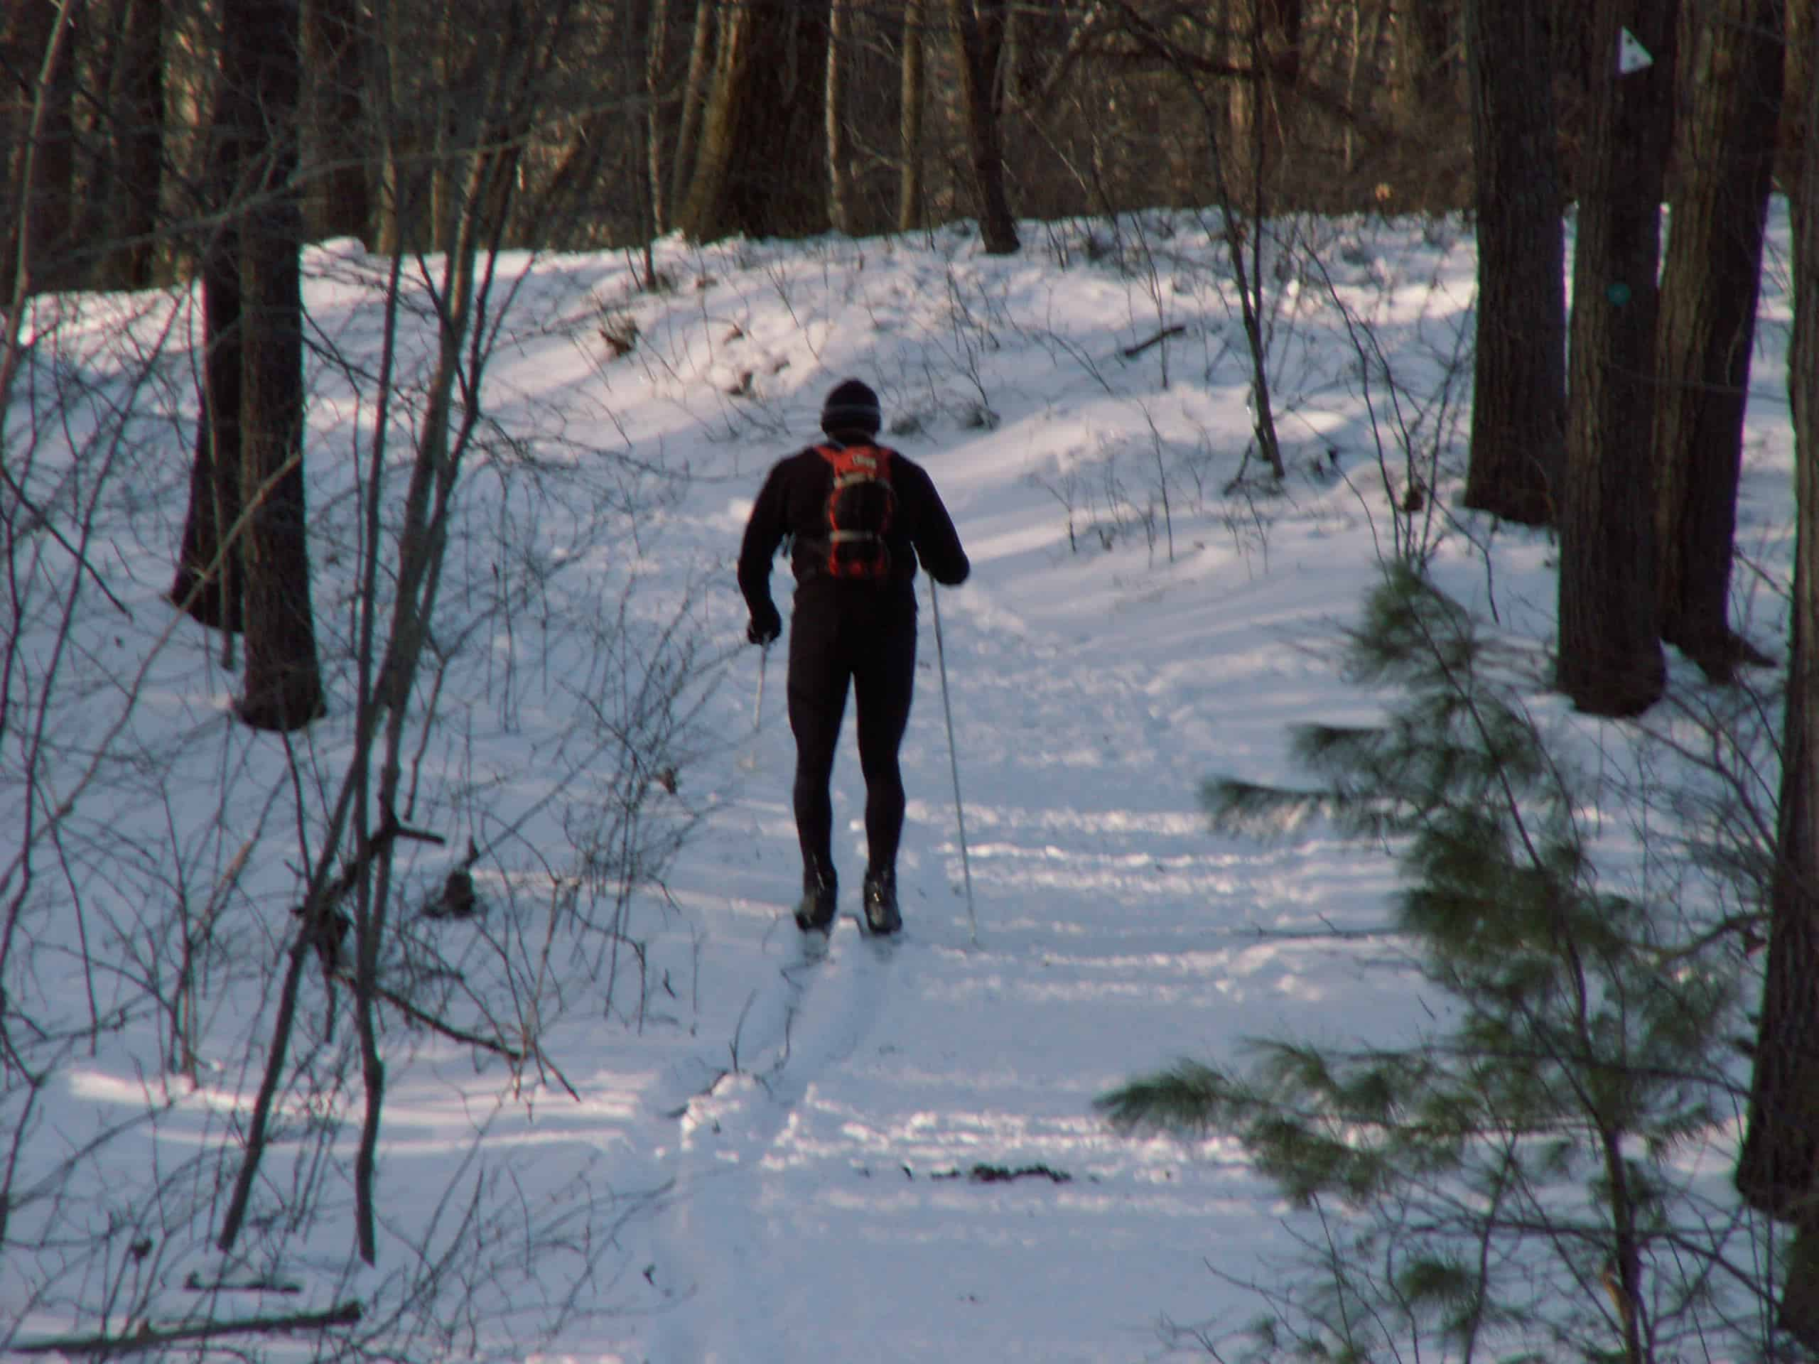
Glimpse of Blue Hills

Slide 3
Project background
Sponsor Background
Friends of the Blue Hills is a non-profit organisation dedicated to conserving and protecting the Blue Hills Reservations' natural beauty and diversified ecology. The reservation has diverse natural features such as trails, hills, beaches, ponds, quarries and wooded areas. The park offers various activities such as hiking, camping, canoeing, and spaces for public gatherings. The park is also home to a museum and weather observatory. Currently all news, events, and scheduled activities are posted primarily on the organization’s website, which limits its reach to a larger audience. In order to reach a larger audience, we proposed a project to research similar organizations to learn how they attract more visitors. Based on that work, we proposed an app including a number of features that will enhance visitors’ experience.

Slide 4
Project Overview & Objectives
Current Situation | The Friends of the Blue Hills currently offers its services through its existing website, which lacks features and functions that would enhance the user experience and increase accessibility of necessary information and resources.
Challenge | Business Problem: The changes we were seeking was to design a feature rich app for Blue Hills so that people explore the beautiful natural resources that the park has to offer. The existing platform-website offers majority of services, events, news and updates which are not sufficient in in bringing all the features together and providing information regarding tours, sporting events, rentals and dining options. Opportunity: The biggest opportunity is to increase awareness about all the activities that are frequently organized at the park and broaden the reach to a larger user base. The app will resolve these issues and add new features that can help the larger community members to explore the park.
Project Objectives | To research similar organizations and gain insight around what kind of features can be included in the design of a web application and propose a list of relevant findings and budget estimation to build such an app.

Slide 5
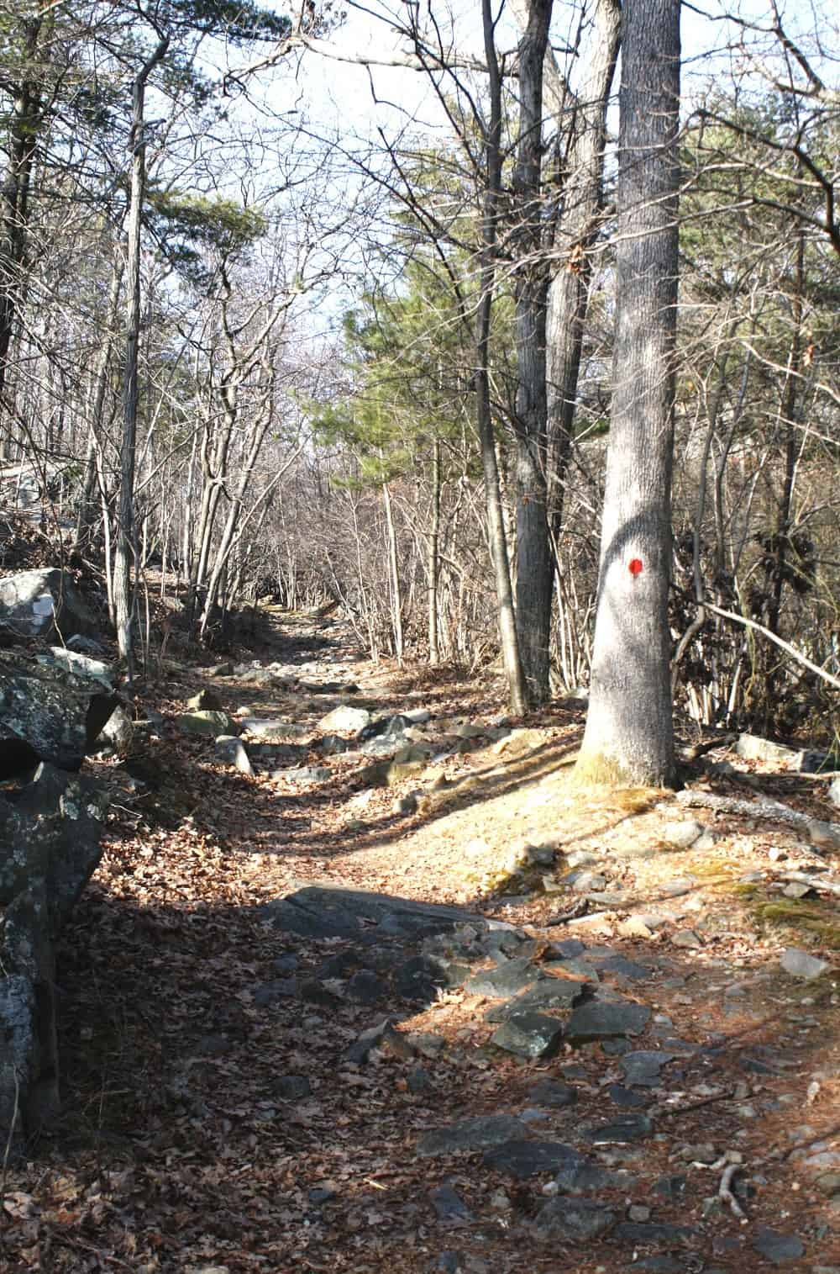
Project Outcomes
Objective 1 | Objective 2
Feature Suggestion to include in the App Navigation integration within the app for hiking Recreational activities Public transport connectivity to the park Dining facilities nearby | Work Completed The visitors and key personnel who are in connection with the Blue Hills were contacted to collect their opinions and suggest features, However; we did not hear back. We researched sites of other organizations that are associated with the Blue Hills to understand what features we may want to replicate on our app.
Objective 3 | Objective 4
Current Status Majority of people in connection with the Blue Hills were inquired. Web-portals of the similar NGO’s were thoroughly researched to collect curated features. | Recommendations for future Designing the prototype/layout of the app pages. Budget estimation to build the app for both iOS and Android platforms.

Slide 6
Issues & Risks to Project Success
 | Risk | Rating | Mitigation | Residual Rating
Risk A | Connectivity issues which can become a problem for people while tracking. | High | Plot milestone stating with numbers to track down the route. | Medium
Risk B | Risk of getting lost while hiking on a trails. | High | GPS enabled map service within the app for every trail and park directions | Medium
Risk C | Risk of sudden change in weather including storms | Medium | Weather forecast would be enabled in the app which will notify people while in the park and provide alert notifications upon reaching to the danger zones. | Medium

Slide 7
Suggested Timeline
Month | 1 | 2 | 3 | 4 | 5 | 6 | 7 | 8 | 9 | 10 | 11 | 12
Phase 1: Blue Hills App Development Project
Development team formation
Set-up operations
Project Kick-off
Phase 2: Development/ Production
Phase 3: Testing and Final Deployment
Stage Gate 1
50% of development is completed &
UAT test can be started
Stage Gate 2
Development and Beta-testing is completed, and app is ready for final release.

Slide 8
Recommendations
Planning Your Trip | Get Involved | Support The Blue Hills
Seasonal events Options for restaurants/food stalls River restoration/clean-up/trail maintenance works- volunteer enrolment Park facility rental options to organize social events Hours & Schedule + Parking Buying options for tickets and passes of all events Get Outdoor: summer camp, school vacation camps, day/night camps | Store for winter gear BHO shirts, T-shirts, caps, tents, weather gears (gloves, socks, boots) or rental options for the same Policy & advocacy (land conservation, wildlife, ecological management, climate change) Advocacy action centre and legislator contact option | Support/Donate Membership options Subscribe (newsletters, magazines etc., emails) Photo/video gallery/sharing option Visitor feedback options (messages-comment section, ratings, audio/video/picture Upload/download option)

Slide 9
How will we Create and Capture Value?
Business Model Canvas
Key Partners Blue Hills Ski Area Blue Hills Observatory Science Centre Mass Dept of Conservation & Recreation Mass Audubon Society Neponset River Watershed Association Brookwood Community Farm | Key Activities Feature Collection/ Requirements Gathering App Development, testing and deployment | Key Resources Development team, QA/QC, Project Team, UX/UI designers Hardware and software infrastructure Servers and licencing 1 Year time span |  | Value Propositions More visitors More shopping locations Place rentals for events Sporting stores Seasonal events Additional help for conservation and maintenance of parks and trails More App users More social media coverage More revenue
Cost structures $63,450- iOS & $60,750- Android (Without Back-end) (For detailed breakdown visit (Here) https://estimatemyapp.com/ |  |  | Revenue Streams Trailing and hiking camps Winter sporting events Stores, stalls and restaurants Educational workshops Paid telecast of live events on app Selling of books and magazines Guest rooms/hotels arrangements

Slide 10
Research Summary
Key research finding 1: | Key research finding 2 | Key research finding 3
Based on following NGO websites we collected the features that can be integrated within our App for UX enhancement and fast growth of the reservation. References Neponset River Watershed Association Brookwood Community Farm Mass Audubon Society (runs the Trailside Museum) Mass Dept of Conservation & Recreation (DCR) Blue Hill Observatory Science Center Blue Hills Ski Area | Researched the park by making a personal visit to know which features can be included. Also, to know that how can we increase the access of community to the different locations of park. Findings: MBTA services required to make a good reach to park Direction boards to navigate within the park Dining facilities Events Sports activities | Contacted relevant people from different organization to know their suggestion for park to be included in the app, however we have not heard back. Explored other organizations that are associated with the Blue Hills to understand what features we may want to replicate on our app. Findings: included in recommendations section

Slide 11
SWOT Analysis
Strengths | Weaknesses
App will include potential features for community to connect with nature as well as people around. Increased interest of people, outreach of the park and social media presence. Built-in map to filter out hike based on terrain and location. | Secured data storage platform needed to avoid data malfunction and to maintain user privacy. Weak performance of the app may not attract number of targeted users. Strong back-end support team is required to maintain the app well-functionable.
Opportunities | Threats
Choose activity/event based on age group. Integrated pre=downloaded map to access it offline. Application will share survey for feedback analysis, rating and reviews on the app store/play store. App will show nearby restaurants, restrooms, fountains, sports gear store along with their relative options, categories and pricing. | Heavy rush of visitors on app during the peak season and hours might leads to more down time. Revenue might not be generated as expected in all seasons as it depends on the number of visitors. Some features working on a third-party license agreements might not work due to lack of support from vendor’s end. App development and deployment could be delayed due to unavailability of unskilled developers and coding errors.

Slide 12
Technology Requirements
Business requirements | The technology adaptation must be sufficient to satisfy all the requirements of the visitors which would help in improving visitors’ experience of the Blue Hills.
Use cases | Navigation for tracking/hiking | App must include dining options | Connectivity options to reach the park
Data | Sources, capture, Storage, transformation, visualisation / presentation, interpretation
3rd party platforms, systems and tools to be used | Facebook, Instagram, Share Point, YouTube, Twitter
Custom software / integration requirements | API integration
Infrastructure requirements | Amazon cloud server
Additional detailed requirements | Separate file attached.

Slide 13
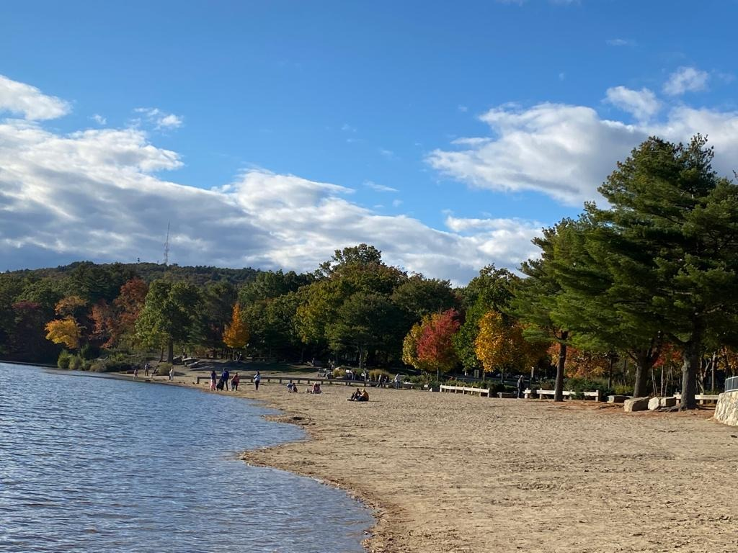
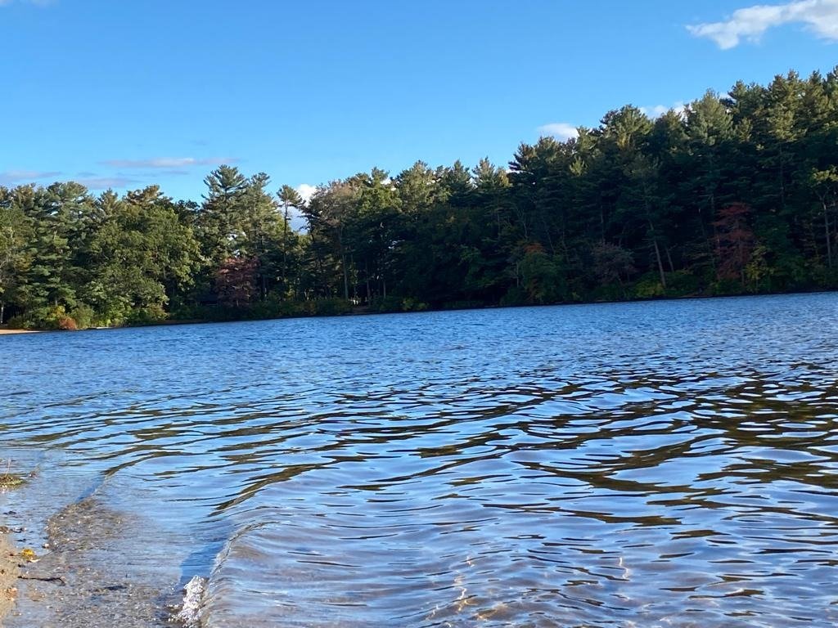
Thank You

